Slide 1
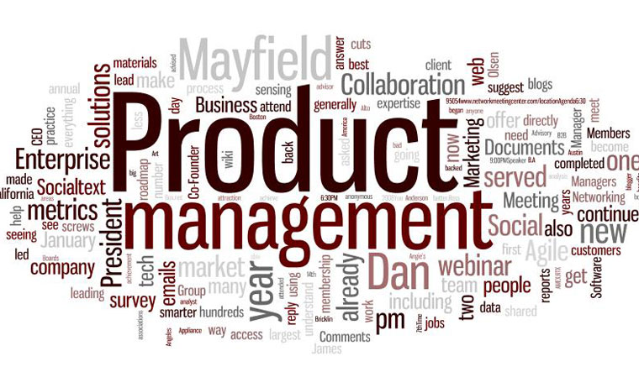

Slide 2
WHAT IS PRODUCT MANAGEMENT?
Product management is a process that focuses on bringing a new product to market or developing an existing one.
It starts with an idea of a product that a customer will interact with and ends with the evaluation of the product’s success in terms of customer-focused framework by means of product excellence.
Product management unites business, product development, marketing, and sales.
Product management is lead by a product manager. Don’t confuse the role with a project manager.
A project manager is responsible for a “single part of a product life cycle – product development”, while a product manager’s responsibility is to lead a “product from the germ of an idea to launch, focusing on features, business value, and the customer”.

Slide 3
FINANCE
LEGAL
MARKETING
R&D
PRODUCT MANAGEMENT
SALES
CUSTOMER SERVICE
MANUFACTURING
OPERATIONS

Slide 4
PRINCIPLES OF MANAGEMENT
principles of management have long been categorized into the four major functions of planning, organizing, leading, and controlling (the P-O-L-C framework).
PLANNING
Vision & Mission
Strategizing
Goals & Objctives
ORGANIZING
Organization Design
Culture
Social Network
P
O
Leadership
Decision Making
Communication
Motivation
LEADING
System/Processes
Strategic human resource
CONTROLLING
L
C

Slide 5
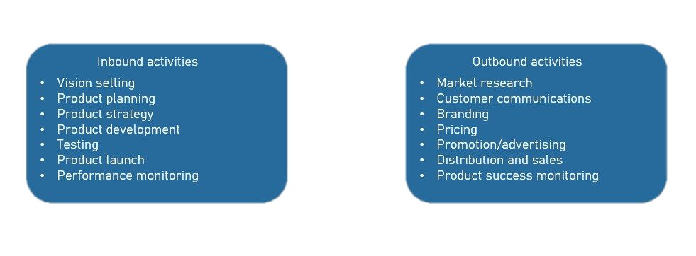
PRODUCT MANAGEMENT ACTIVITIES
Tasks in product management cascade from strategic to tactical. The whole process of product management involves inbound and outbound activities. A product manager doesn’t perform all activities but rather supervises their fulfillment.

Slide 6
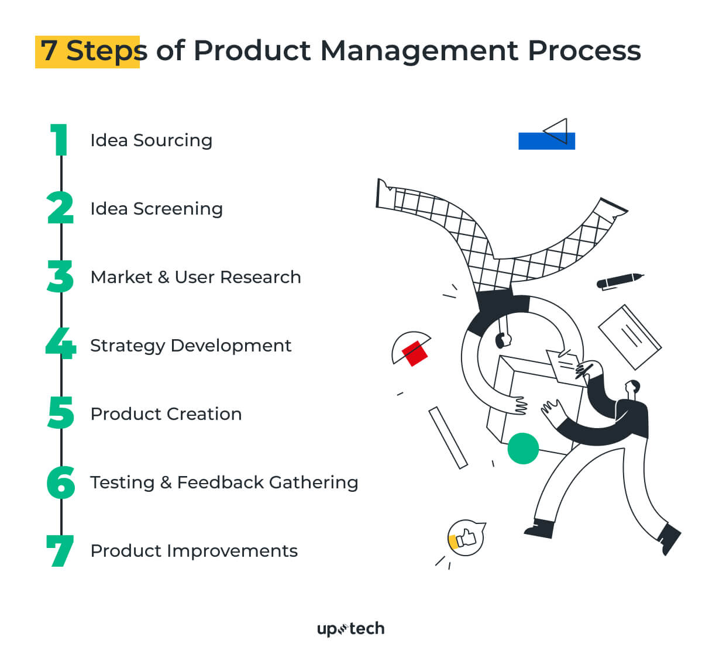
STEPS OF PRODUCT MANAGEMENT PROCESS
Step 1 – Idea Sourcing
Research.
Brainstorm.
Step 2 – Idea Screening Product
Management Tip:
What problem do I try to solve?
How do I understand it's successful?
How do I want people to talk about my idea?

Slide 7
STEPS OF PRODUCT MANAGEMENT PROCESS
Step 3 – Market Research & User Research
Evaluating the size of a target market
Exploring the competitors
Finding out the competitors' weaknesses
Looking for the scope for improvement
Step 4 – Strategy Development
Business goals and objectives
Product areas
Features of a product
Key performance indicators (KPIs)
Order of priorities
Step 5 – Product Creation
It's better to focus on the value.
Step 6 – Testing & Feedback Gathering
Heck how a user interacts with your product, capture feedback, find possible improvements.
Step 7 – Constant Product Improvement
Though the software product management process is not the endpoint, at this stage, things are coming to sustaining your business.

Slide 8
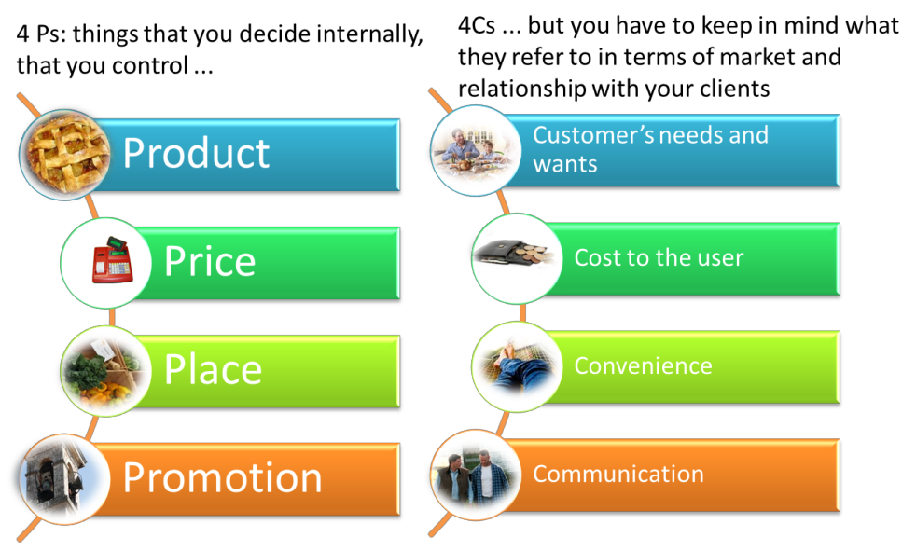
MARKETING MIX

Slide 9
HIERARCHY OF PRODUCT MANAGEMENT
Head of product
Senior product manager
Product lead
Principle Product Manager
Product owner
Chief product officer
Product manager
Product director
Junior product manager

Slide 10

WHAT IS A PRODUCT MANAGER?
A product manager is the person who creates internal and external product vision and leads product development from scratch.
This individual defines customer needs, works with stakeholders and teams on creating the required product, and carries responsibility for overall product success.
They also formulate and oversee the strategies behind both digital and physical products.

Slide 11
FUNCTIONS OF PRODUCT MANAGER
1. Conducting research
2. Developing a strategy
3. Communicating plans
4. Coordinating development
A Pharmaceutical Product Manager performs an array of functions in an organization. Here are some processes performed by a product manager:
Needs to stay up to date
Studying current market trends
Research and apply those learnings to crafting a high-level strategic plan.
It will solve that market’s specific challenges.
To translate this information into a format they can communicate across the organization
Involve pulling together the various teams.
Ensure everyone shares the same understanding of the plan and goals.

Slide 12
PRODUCT MANAGEMENT STRATEGIES
A product management strategy defines what an organization wants to achieve with its product.
Once you have the vision, know the market, and understand customers’ needs, a specific product strategy has to be formulated accordingly.
Here’s a step-by-step guide on how to create effective product management
Get to know your customers strategies.
Know everything about the product
Identify your product goals and objectives
Build a product roadmap
Data analytics
Product strategy is typically documented in a written roadmap form that would allow a team to control the work at all stages. A roadmap (brand plan) is a tool that provides a framework for a team with a timeline and specific actions, illustrates the vision, goals, and the current state of product development.

Slide 13
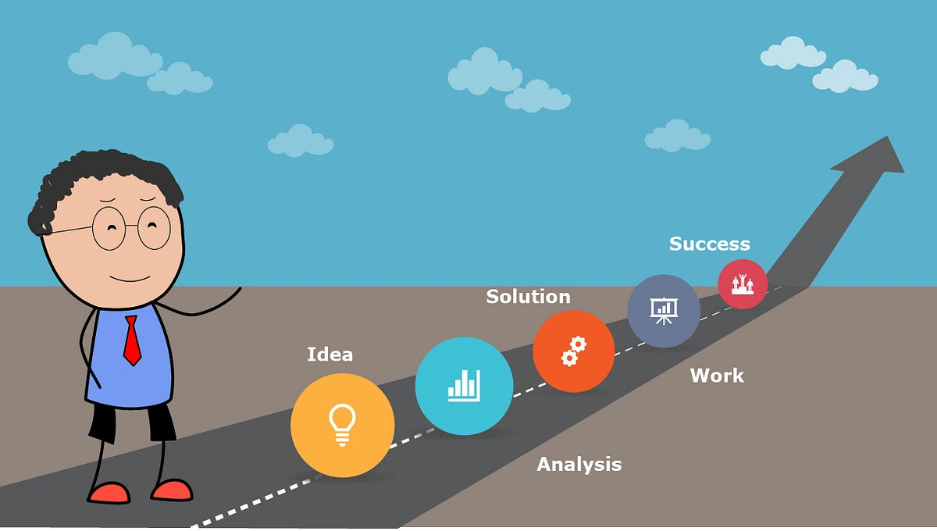
BRAND PLAN
A brand marketing plan is a roadmap that outlines all the strategies, tasks, activities and costs that would be needed to make your venture a success. A branding plan includes not just the visual aspects of the brand like the logo and colors, but also information like:
A clear description of what your brand represents.
Consistent brand messaging for audience communication.
Attainable goals for brand reach and recognition.
Executable marketing strategies to use to reach your brand goals.

Slide 14
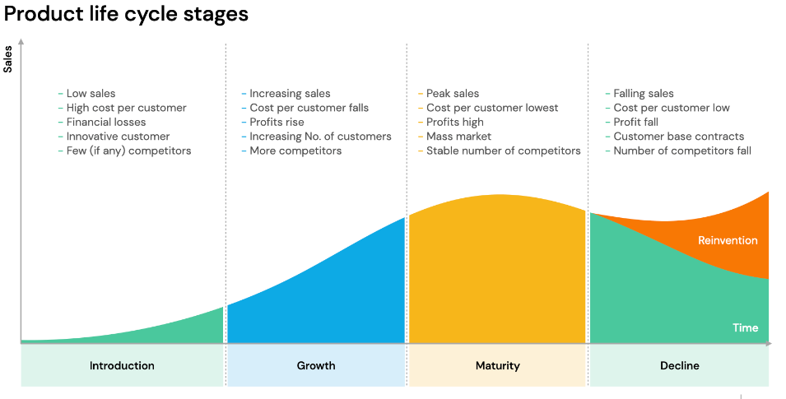

Slide 15
THE DUTIES WHEN YOU PURSUE A CAREER IN PRODUCT MANAGEMENT:
Specify research necessary to obtain market information Determine customer needs
Recommend scope and nature of present and future products Review product specs and features and determine improvements
Provide data about current product offerings that can be used for market communication Bring new products into the market Determine pricing
Develop time-integrated plans working with different departments such as production, advertising, marketing, and sales
Contribute to the overall team effort to accomplish the company's mission and vision and to achieve all the goals set by the team

Slide 16

THANKS!

